Slide 1

Meme-Machine
Brought to you by: char broiled;
Group Members:
Matthew Jagielski, Jacob Bieker, Ian Garrett, Theodore LaGrow

Slide 2
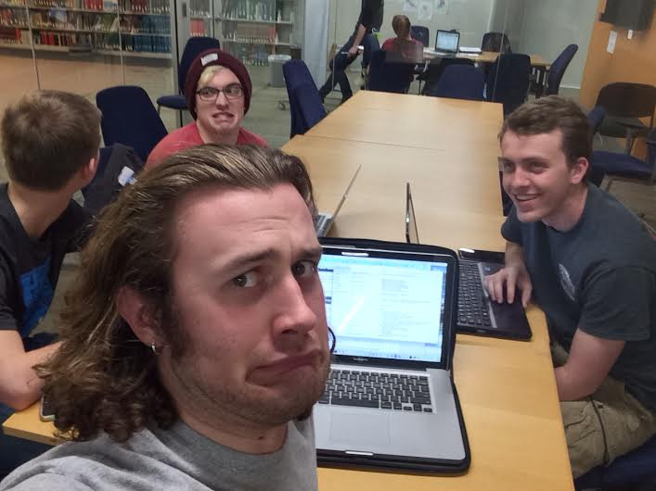
Overview of Project
Code so hard
Server/Client Chat
Encryption
Meme-afy
Qt Gui
Memes wanna
find me

Slide 3
Overview of Project
Code so hard
Server/Client Chat
Encryption
Meme-afy
Qt Gui
Memes wanna
find me

Slide 4
Code so hard
Memes wanna
find me

Slide 5
Overview of Project
Code so hard
Server/Client Chat
Encryption
Meme-afy
Qt Gui
Memes wanna
find me

Slide 6
Overview of Project
Code so hard
Server/Client Chat
Encryption
Meme-afy
Qt Gui
Memes wanna
find me

Slide 7
Overview of Project
Code so hard
Server/Client Chat
Encryption
Meme-afy
Qt Gui
Memes wanna
find me

Slide 8
Overview of Project
Code so hard
Server/Client Chat
Encryption
Meme-afy
Qt Gui
Memes wanna
find me

Slide 9
Overview of Project
Code so hard
Server/Client Chat
Encryption
Meme-afy
Qt Gui
Memes wanna
find me

Slide 10
Overview of Project
Code so hard
Server/Client Chat
Encryption
Meme-afy
Qt Gui
Memes wanna
find me

Slide 11
Demonstrations

Slide 12
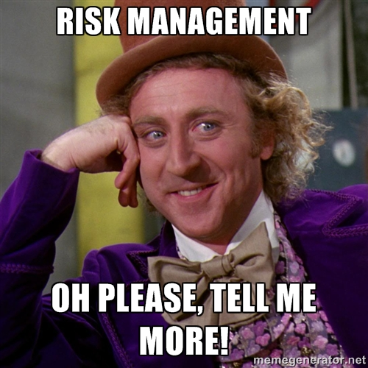
Risk Management
Make sure we can run all of the code on our own computers
We didn’t get everything hooked up
Server could not take pictures
GUI unexpectedly quits after encrypt class is called
The styling of the memes can be added upon

Slide 13

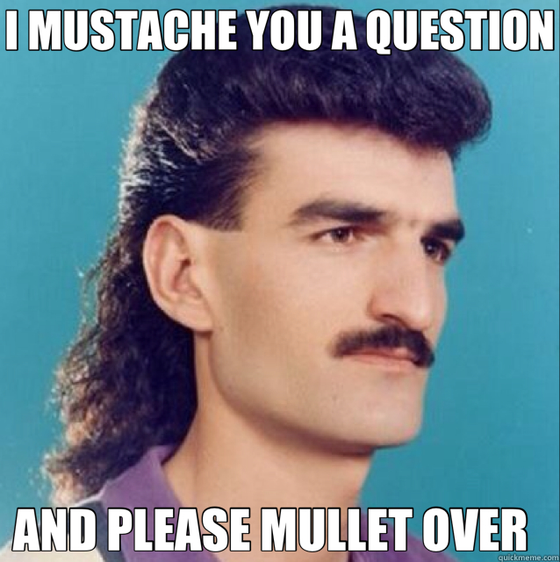
Questions?

Slide 14
Thank you!

